Slide 1


Word Analogy Finder
Word analogies are a fundamental aspect of language comprehension and reasoning. Understanding these relationships is crucial for developing critical thinking skills, expanding vocabulary, and deciphering complex linguistic patterns.
Team 45 :-
Members :-
Nandan Murari – SE22UARI110
Kalyan – SE22UARI192
K Sharath – SE22UARI077
Aitha Abhi – SE22UARI009

Slide 2


Introduction to Word Analogies
Definition
Importance
Word analogies involve identifying and comparing relationships between pairs of words, revealing similarities or contrasts. For example, "hot" is to "warm" as "cold" is to "cool," highlighting a relationship of synonyms.
Word analogies enhance cognitive abilities like critical thinking, problem-solving, and vocabulary development. They expose individuals to diverse language structures, fostering linguistic awareness and analytical skills.

Slide 3

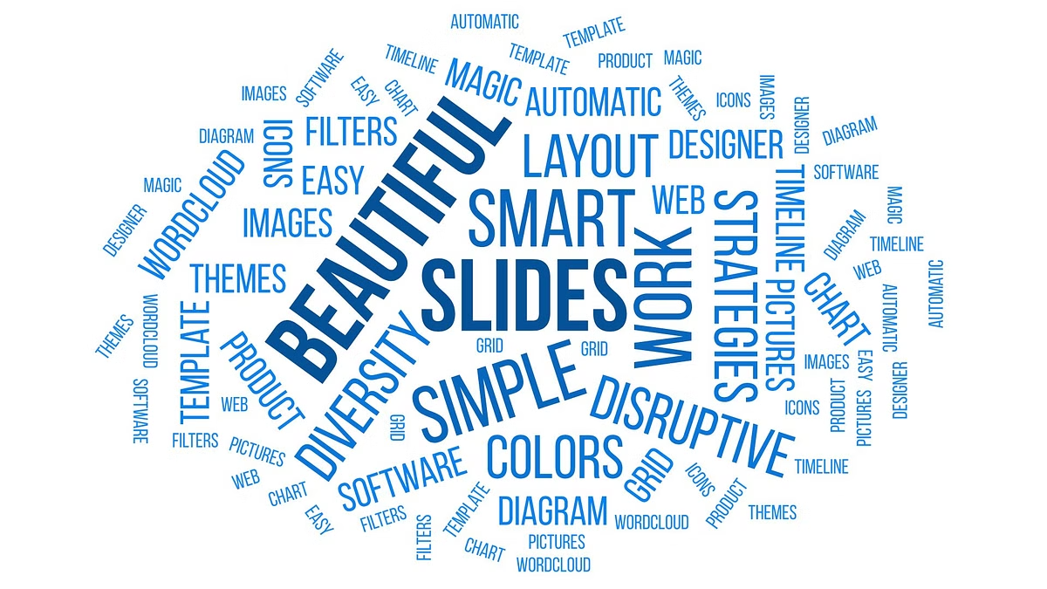
Types of Word Analogies
1
Synonyms
2
Antonyms
Synonyms are words that have similar meanings. For instance, "big" is to "large" as "small" is to "tiny," showcasing pairs with comparable definitions.
Antonyms are words with opposite meanings. For example, "up" is to "down" as "happy" is to "sad," highlighting contrasting relationships between words.
3
Part to Whole
4
Cause and Effect
This type examines the relationship between a part and its whole. For example, "wheel" is to "car" as "branch" is to "tree," emphasizing the constituent parts within a larger entity.
Cause and effect analogies connect actions or events with their consequences. For example, "rain" is to "wet" as "fire" is to "burn," showcasing the relationship between a cause and its subsequent effect.

Slide 4




How a Word Analogy Finder Works
Input
Analysis
Output
Users provide two pairs of words, allowing the system to analyze their relationships.
The system employs algorithms, including machine learning or rule-based approaches, to identify patterns and relationships between the words.
Based on the analyzed patterns, the system predicts the missing word in a new pair, completing the analogy.

Slide 5
Key Algorithms Behind Word Analogy Finders
Word Embeddings
Machine Learning Models
Words are represented as vectors in a high-dimensional space, capturing their semantic relationships. Analogies are solved by performing vector arithmetic, such as "king - man + woman = queen," demonstrating the relationship through vector operations.
Algorithms like neural networks and transformers are trained on extensive datasets of analogies, allowing them to learn complex patterns and relationships between words. These models can then predict missing words based on the learned patterns.

Slide 6





Applications of Word Analogy Finders
Education
Natural Language Processing
Creative Writing
Word analogy finders aid students in enhancing their language and reasoning skills, improving their comprehension and analytical abilities.
These tools enhance machine comprehension and language generation, enabling machines to understand and interact with human language more effectively.
Word analogy finders assist writers in generating fresh ideas, finding descriptive language, and exploring diverse linguistic possibilities.

Slide 7


Challenges and Limitations
Cultural Bias
Algorithms may reflect biases present in the training data, potentially perpetuating stereotypes or discriminatory outcomes.
Language Diversity
Extending analogy finders to non-English or low-resource languages poses significant challenges due to the complexities and variations in different languages.
Ambiguity
Analogies can be subjective and context-dependent, leading to potential misinterpretations or multiple valid solutions.

Slide 8


Conclusion and Future Prospects
Summary
Word analogy finders are valuable tools for both language learning and advancing Natural Language Processing (NLP) capabilities. They provide insights into the intricate relationships between words, enhancing our understanding of language and its intricacies.
1
2
Future
Future research aims to improve algorithms, mitigate bias, and expand the scope of analogy finders to support a wider range of languages. These advancements will further enhance the utility and effectiveness of these tools for various applications.

